Slide 1

Presentation On
Medicine Reminder App
Presented By :-
Pratik Tikande (64)
Pranav Waghmare (70)
Rahul Thatar (63)
Tejas Veer (67)
Guided By :- Prof. Shital Ajagekar

Slide 2
Outline Of Presentation
Introduction
Literature survey
Motivation and challenges
Problem Statement
Tech and Tools
Algorithm
Flowchart
Results / Outputs
Conclusion
References

Slide 3
Introduction
Some Times Patients Required To Take there Required Medicine At That Time
Also Forgot Which Medicine He/She should Take At that Time
This is particularly true for old patients who have to take more than one medicine at more than one time in a day.
To Overcome This we Try To Design The Medicine Reminder Application

Slide 4
Literature survey
Year Of Publication | Year Of Publication | Author | Overview
A case study of medication reminder system | 2018 | Mohammad Alhaj | Health system; Medication management; Medication reminder system; HW/SW Co-design; Behaviour driven development
Smart Medicine Reminder for Old People | 2015 | Mayuresh Waykole, Vatsalya Prakash, | Our system aims to reduce this problem by reminding patients about their medications and showing them the correct amount of medication to take.
GoMed: Daily Medicine Reminder Application | 2013 | Afshaan Sarguroh1 , Munaf Shaikh2 , Kashif Khan3 , Dr. Zainab Mirza4 | This app will have a positive impact on people as it will act as a companion that can display reminders and notify the user to take the pills on time supporting Medical adherence and improving health.

Slide 5
Motivation and challenges
When You want To Give Up Remember Why You Started
To Help The Old Age People Who Has Less Memorizing Power
To Remember Our Daily Medicine
To Create The User Friendly Interface Of Reminder Application
Challenges
To Collect The Require Data
Add Alarm Activity In App
To Add The Dialog Box In Fragment

Slide 6
Problem Statement
Majority of patients forgot to take medicine as it is prescribed
Its Difficult task for the physician is to attempt to open the eyes of patients to take medicine at right time.
So We Develop The Reminder Application which People Can use as Sticky notes Medication reminder as well as Tab time Vibe Vibrating pill Timer Reminder

Slide 7

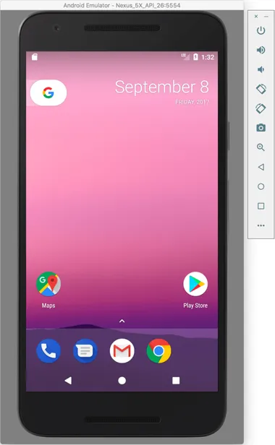

Technology and Tools

Slide 8
Algorithm
Step 1:- Start
Step 2:- Open Home Activity If User Click On Widget Then Open Widget
Else Return Home Activity
If User Click on Add activity Then Add Description Open
Else Return Home activity
Step 3:- If User add Reminder then Datastore in Database and Home Activity receive fragment
Else Return Add Description
Step 4:- If the Time is Correct Then Notify Else Wait
Step 5:- If Notify Then Medicine Is Taken else Datastore In Data database
Step 6:- If Medicine Is Taken Then Receive A Dialog box else Task Pending
Step 7:- If Dialog Box Receive then History will clear And Go To Home Activity
Else Task Pending
Step 8:- Exit

Slide 9
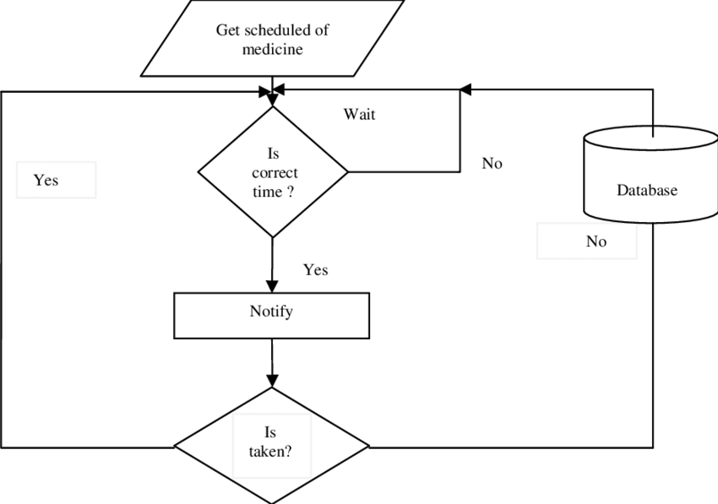
Flowchart

Slide 10
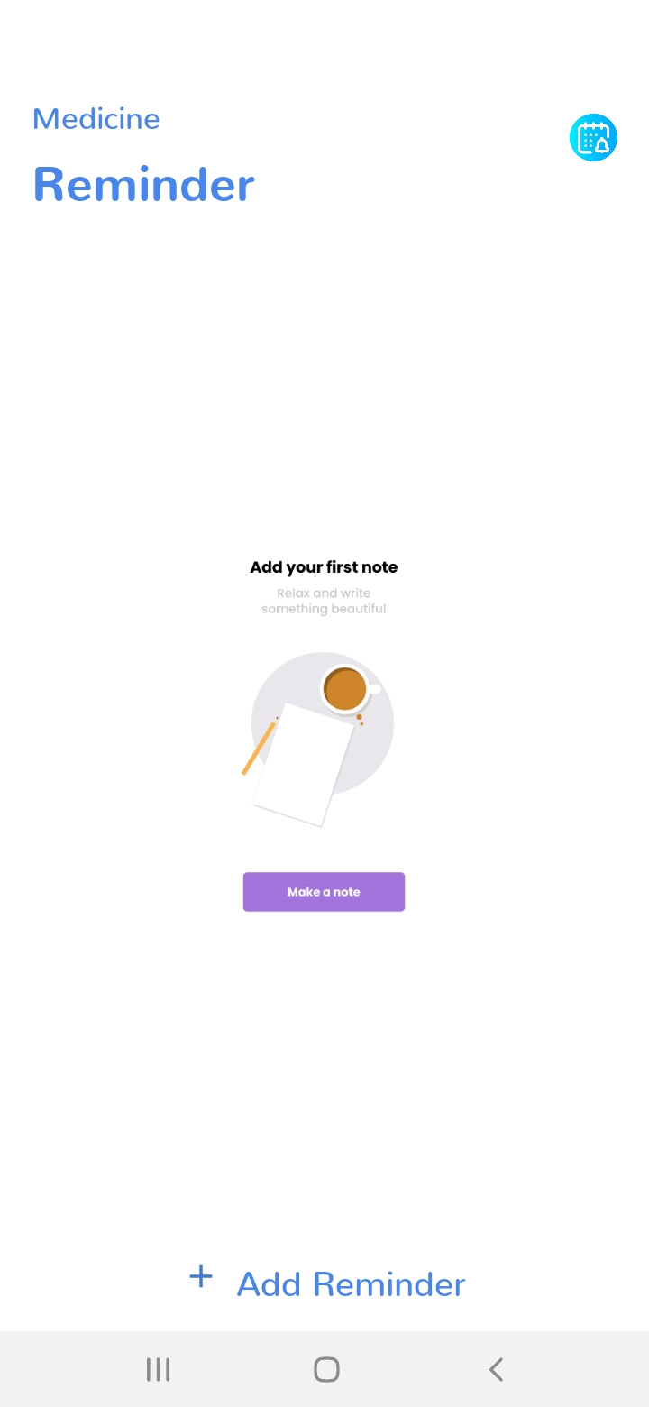
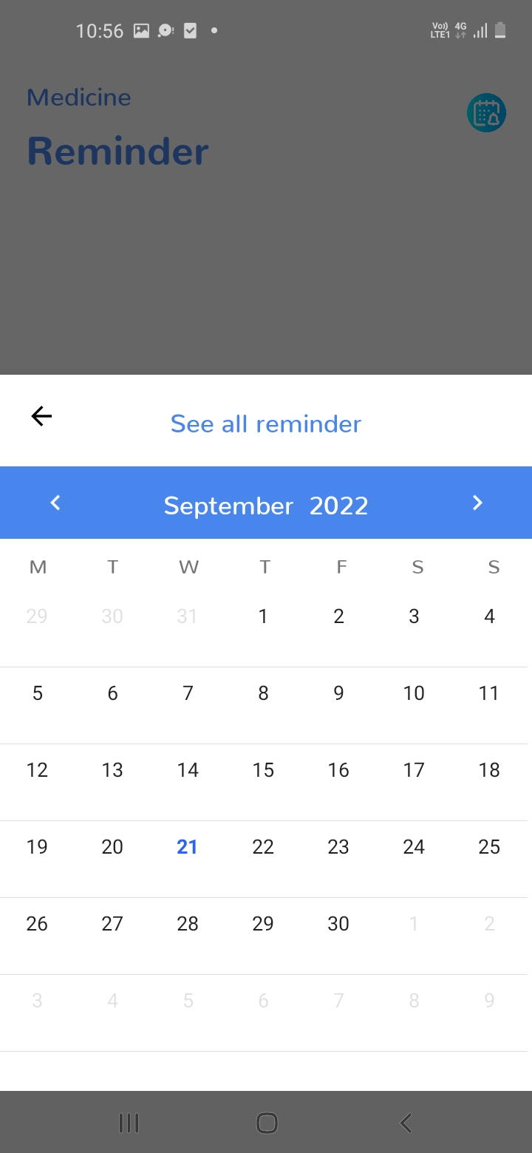
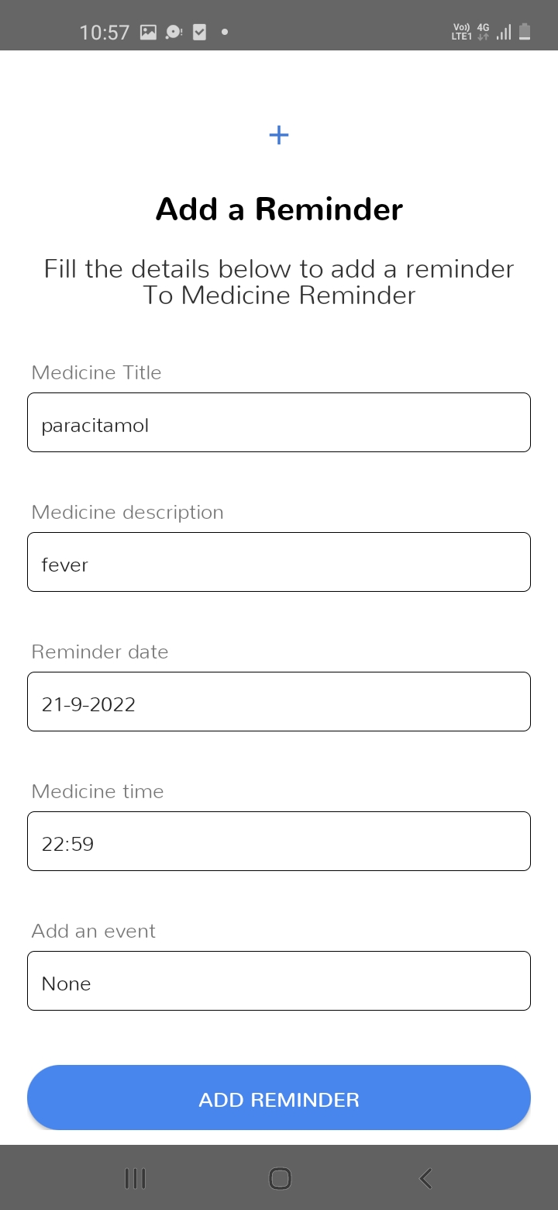
Results / Outputs

Slide 11
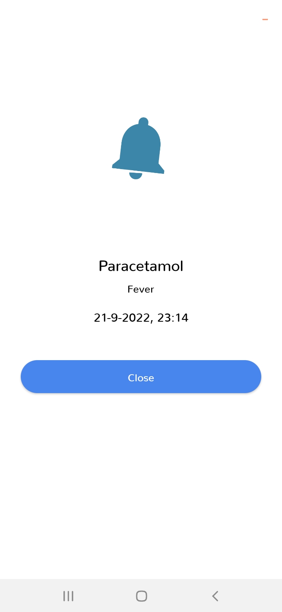
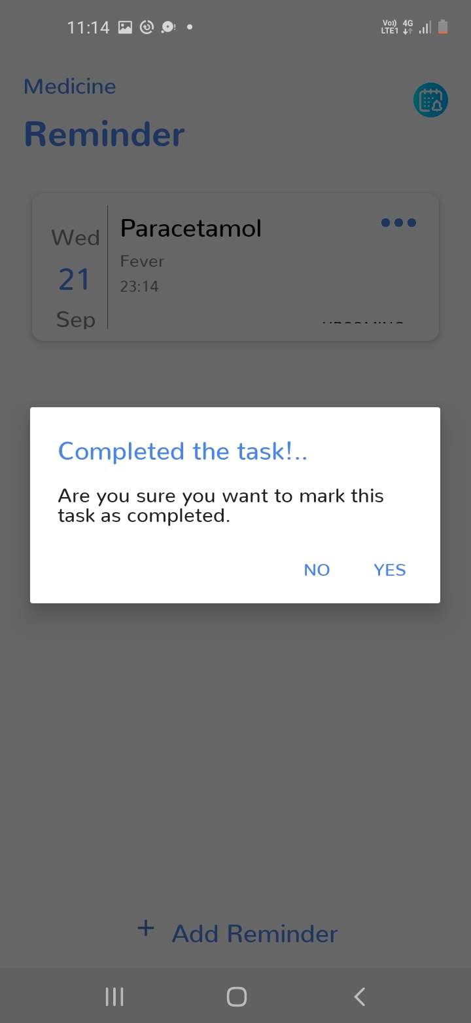
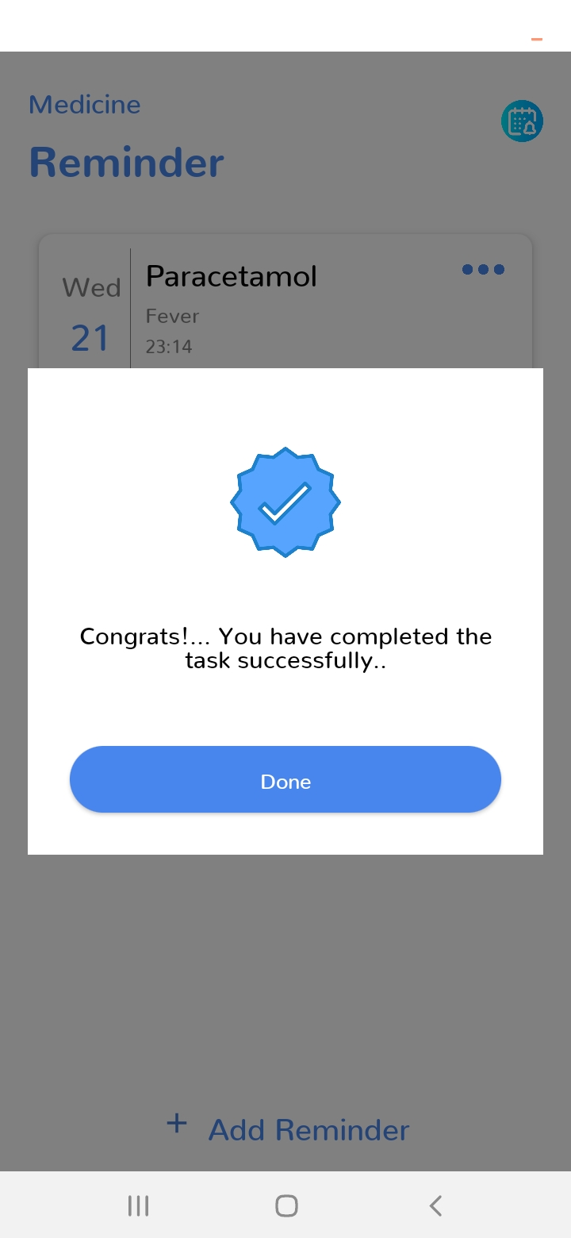
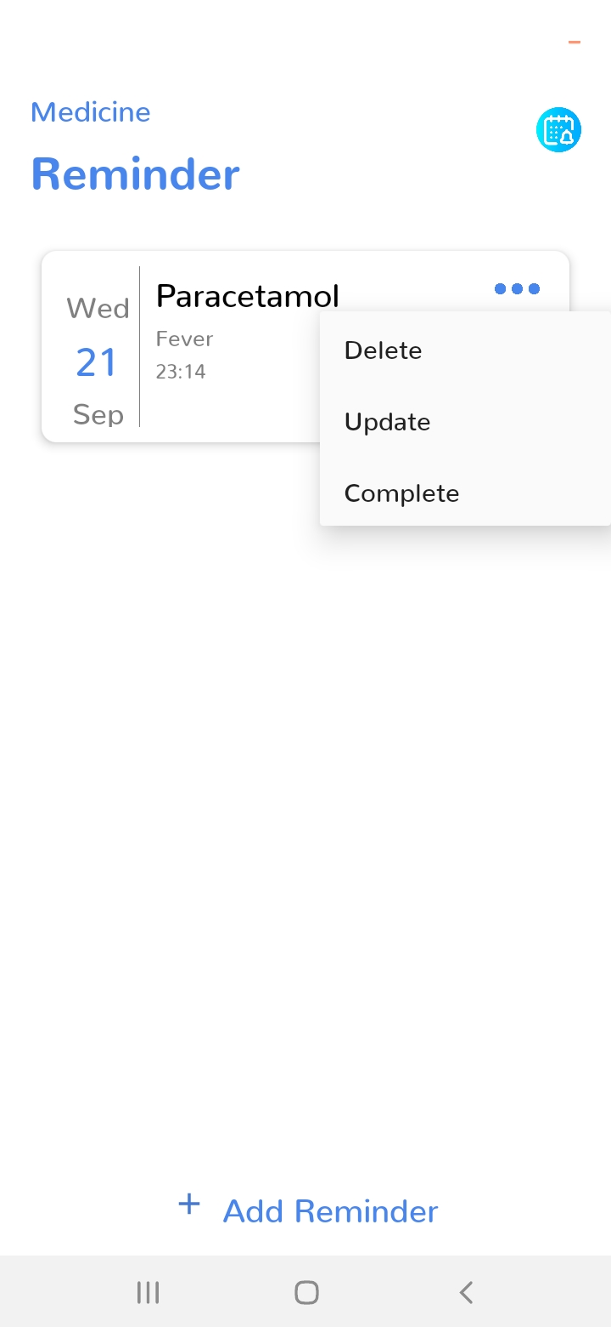
Results / Outputs

Slide 12
Conclusion
The Medicine Reminder Will Be Very Helpful For patients
It Helps To Took Proper Medicine At Right Time
It can also help a working person with a busy schedule by sending him a notification on the device he uses full day, his mobile phone.
The cost of Production is low as compared to other Problem Solution
The Medicine Reminder Application Will be open Soure

Slide 13
References
www.github.com/pratiktikande
www.youtube.com
www.androiddevlopers.com

